Slide 1

analysis, Brazilian E-commerce store for the time period 2016-2018
There are 9 datasets to play with and explore. The data model has been described in image below and it is organised and Normalised for each category.

Slide 2
Sales for different states over years in Brazilian E-commerce store

Slide 3
Count Payment Type in Brazilian E-commerce store

Slide 4
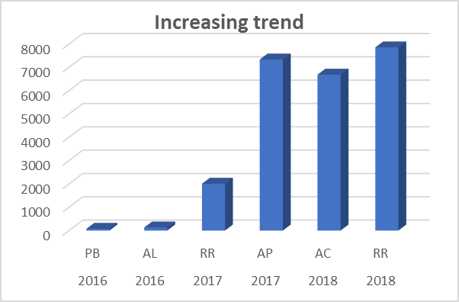
Top 2 States Increasing trend over the years in Brazilian E-commerce store

Slide 5
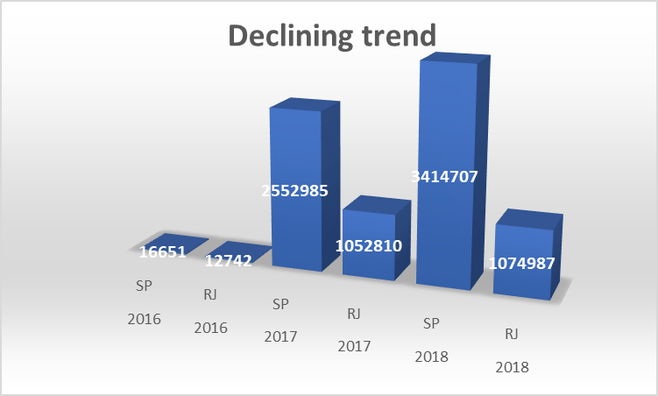
Top 2 States Declining trend over the years in Brazilian E-commerce store

Slide 6
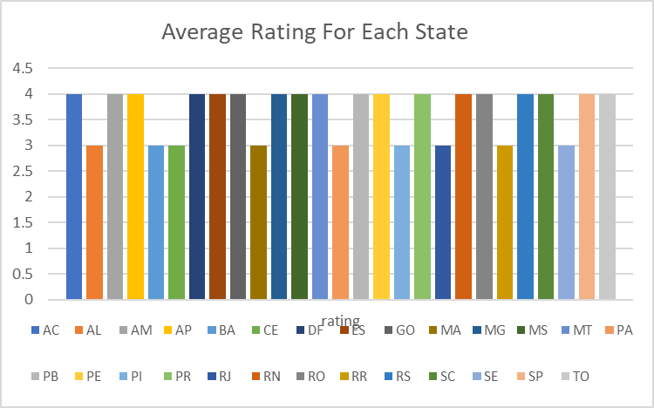
Average Rating For Each State in Brazilian E-commerce store

Slide 7
CATEGORY-WISE Total Revenue in Brazilian E-commerce store

Slide 8
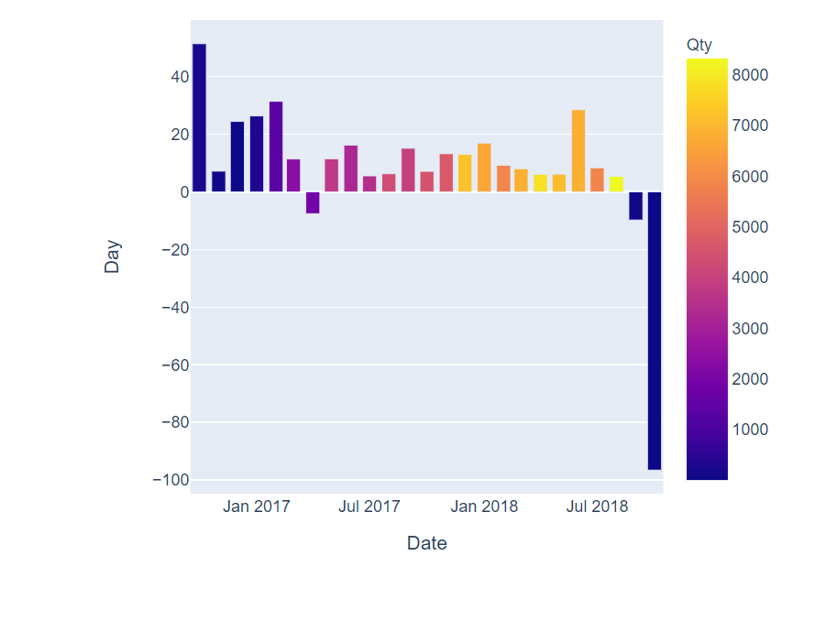
Delivery Interval (Estimated vs Actual) per Month data in Brazilian E-commerce store

Slide 9
Conclusion
Make sure that delivery partners deliver products on time or before.
Add some more delivery partners who are reliable and have a good record in their deliveries across the states for faster delivery.
To improve sales and rating of few states which are having comparatively overall low ratings to other states, we can provide some special offers in those states.
Customer satisfaction should be at the topmost priority for the company from the user landing on the page of the website or the application for a product search to the end of delivery till the product reaches the customer safely.
Here we can see that as the usage is very high of credit card for the payment purpose so we can contact more banking partners who provide the credit card facility , so that we can earn a better percent of revenue from them for making customers use their services.

